Slide 1

KLMUG13
-- Mongoid Ruby & GeoJSON --
Website: http://nosqlasia.org
FB: http://fb.com/groups/klmug
Twitter Handle: @klmug
--------------------------------------------------
GitHub: github.com/r1dotmy/klmugs
Notes:
1

Slide 2
REMINDERS
20 / 30 - Minute Presentations (use cases or technical demonstrations)
5 / 10 - Minute Lightening Talks
(knowledge share / shout-out)
BIG emphasis on Q&A
Notes:
2

Slide 3
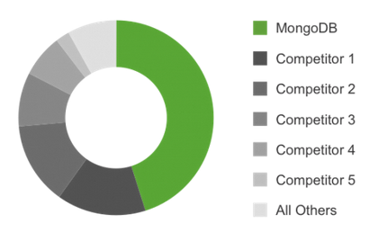
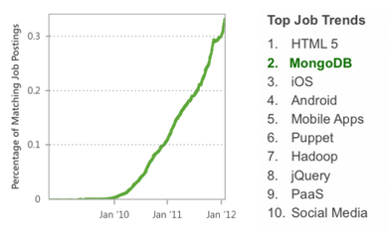
10gen formed in 2007
Originally planned as a cloud computing stack …
Fastest growing big data
Community / adoption …
Top chart shows Linked In
Bottom charts shows Indeed.com
10gen Education now rebranded
As MongoDB University
10gen is now MongoDB
Notes:
3

Slide 4


Exploring Mongoid (Ruby)
With N. V. Nguyen (Says.com)
GeoJSON in 2.4+
With Tim Chandler (PraxisBT)
Notes:
4

Slide 5
JUST IN CASE

Slide 6




DATA AT THE APPLICATION LEVEL
“In 2012, NoSQL document stores like MongoDB received more than 70 percent of total
big-data tool demand. MongoDB from 10gen remains the top performer in this group.”
-- CNET
MongoDB Clients:
How MTV use mongoDB as a CMS - http://www.10gen.com/presentations/mongonyc-2011/how-mtv-networks-leverages-mongodb-for-cms
Notes:
6

Slide 7

EXCELLENT GEOLOCATION SUPPORT
Have you ever heard of Foursquare …?
Notes:
7

Slide 8
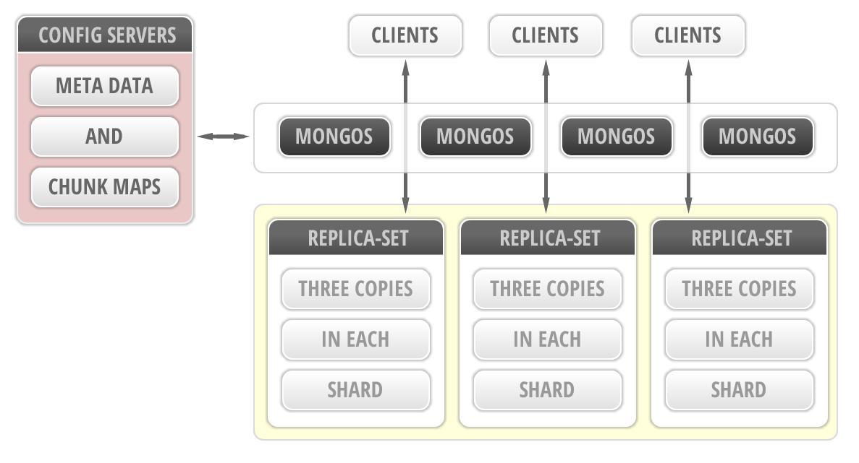
REPLICA-SETS AND SHARDING
Notes:
8

Slide 9

IT’S LIGHTENING FAST !!!
Some say 6,000 times faster than MySQL – http://lauli.ma/geo1
Notes:
9

Slide 10
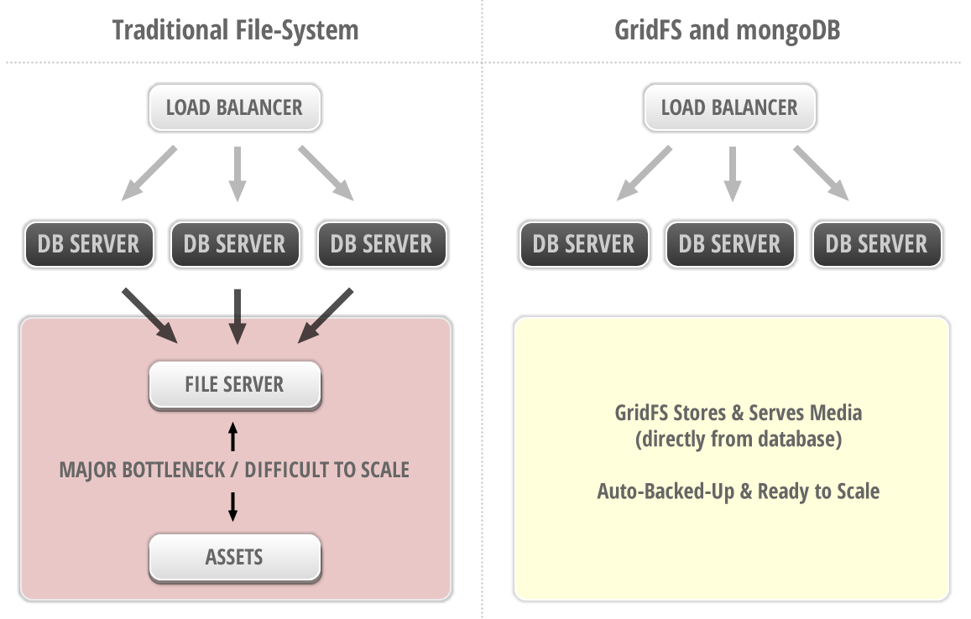
GRIDFS – MEDIA STORAGE & SERVING
Notes:
10

Slide 11

NO LANGUAGE BARRIERS
( ALSO KEEPS ALL LOGIC IN ONE PLACE )
Notes:
11

Slide 12
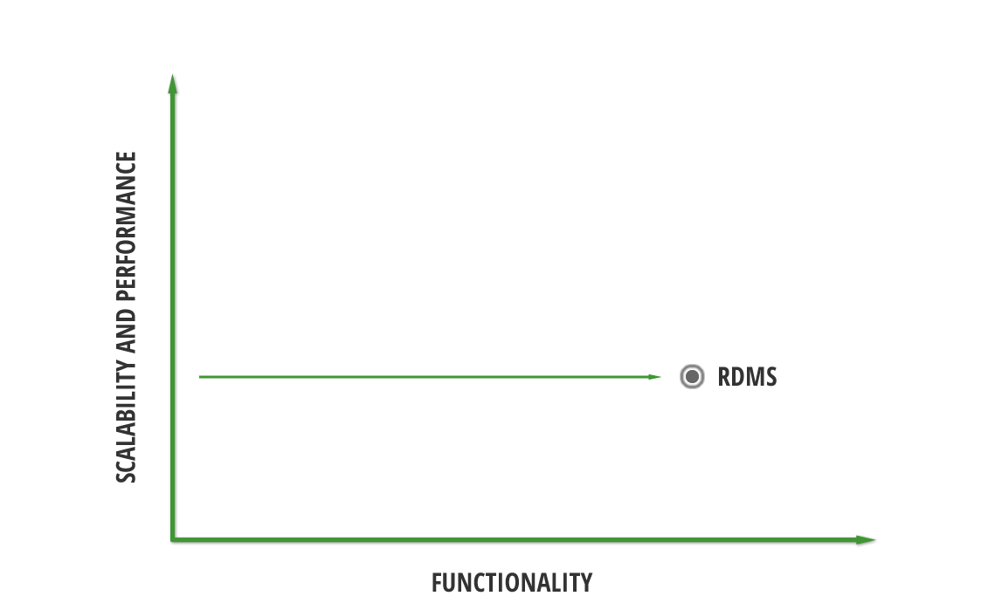
PERFORMANCE - VS - FUNCTIONALITY
Notes:
12

Slide 13
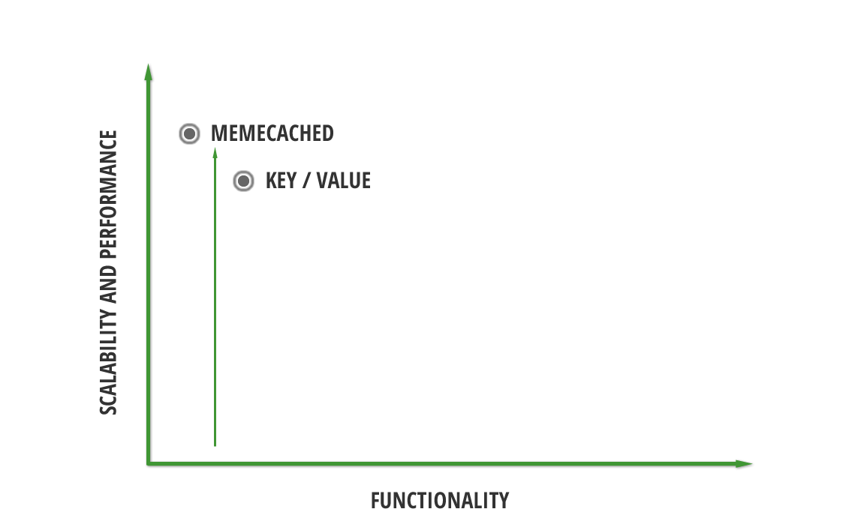
PERFORMANCE - VS - FUNCTIONALITY
Notes:
13

Slide 14
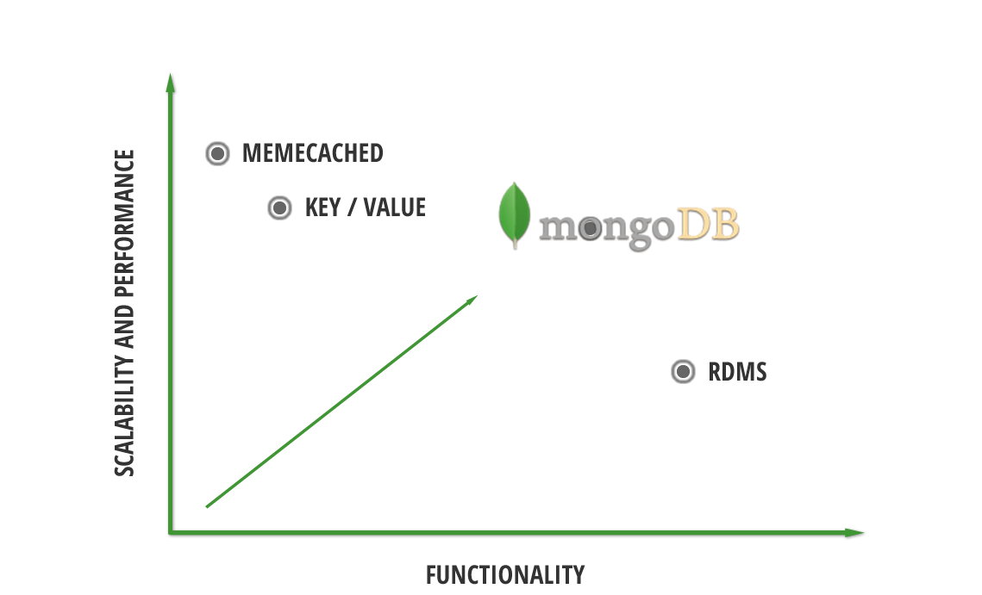
PERFORMANCE - VS - FUNCTIONALITY
Notes:
14

Slide 15

THERE IS NO SPOON !!!
( OR NEED TO LEAVE YOUR APP )
Notes:
15

